Slide 1

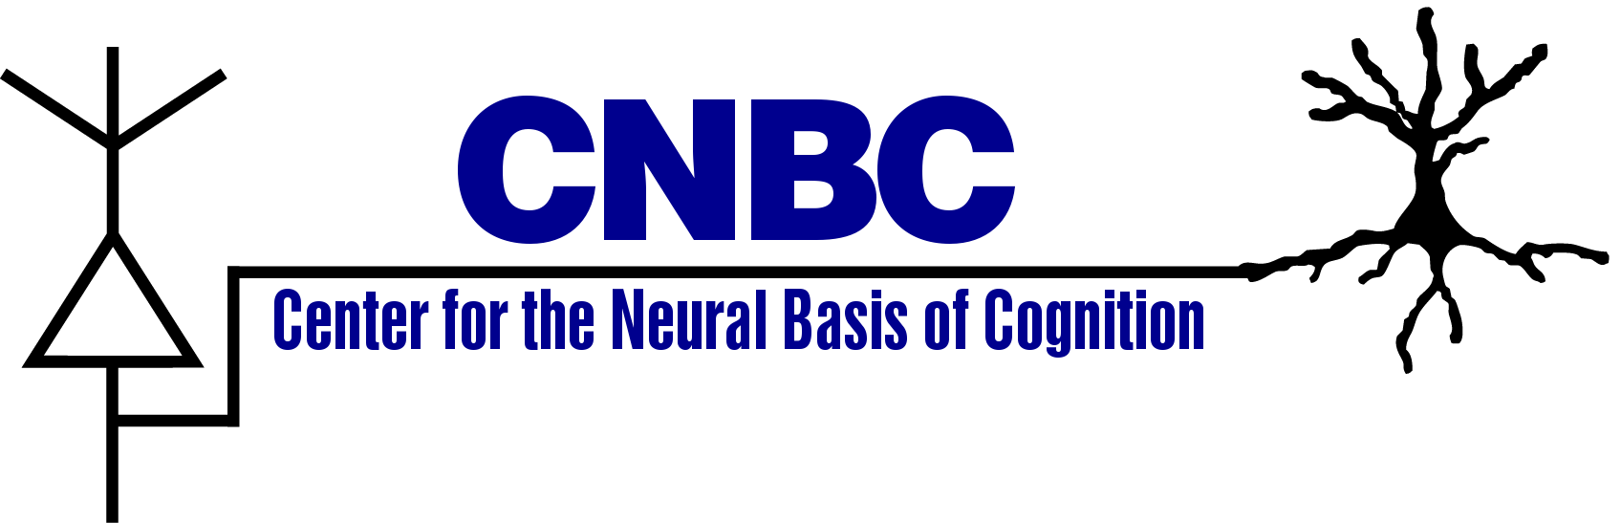

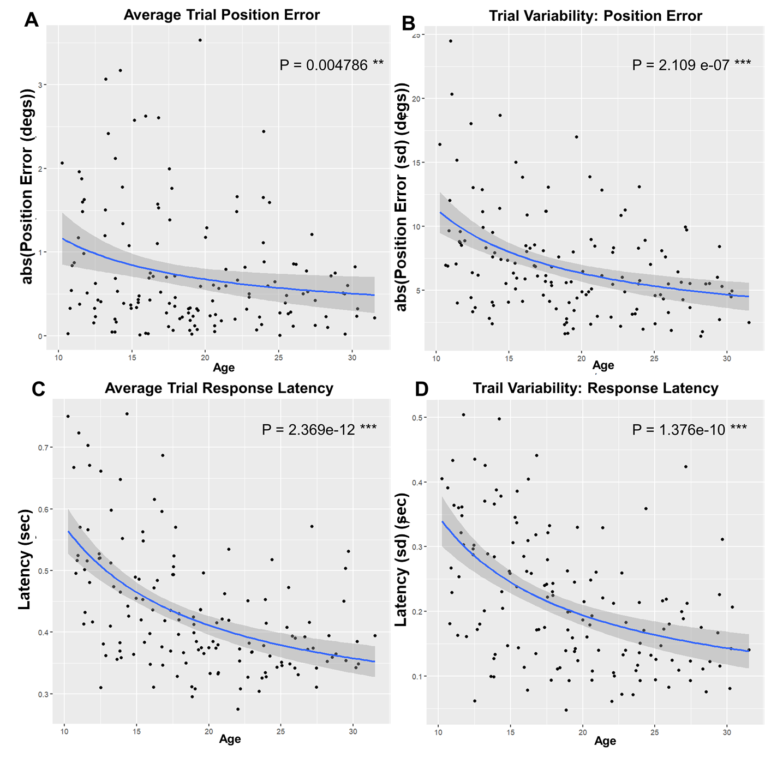
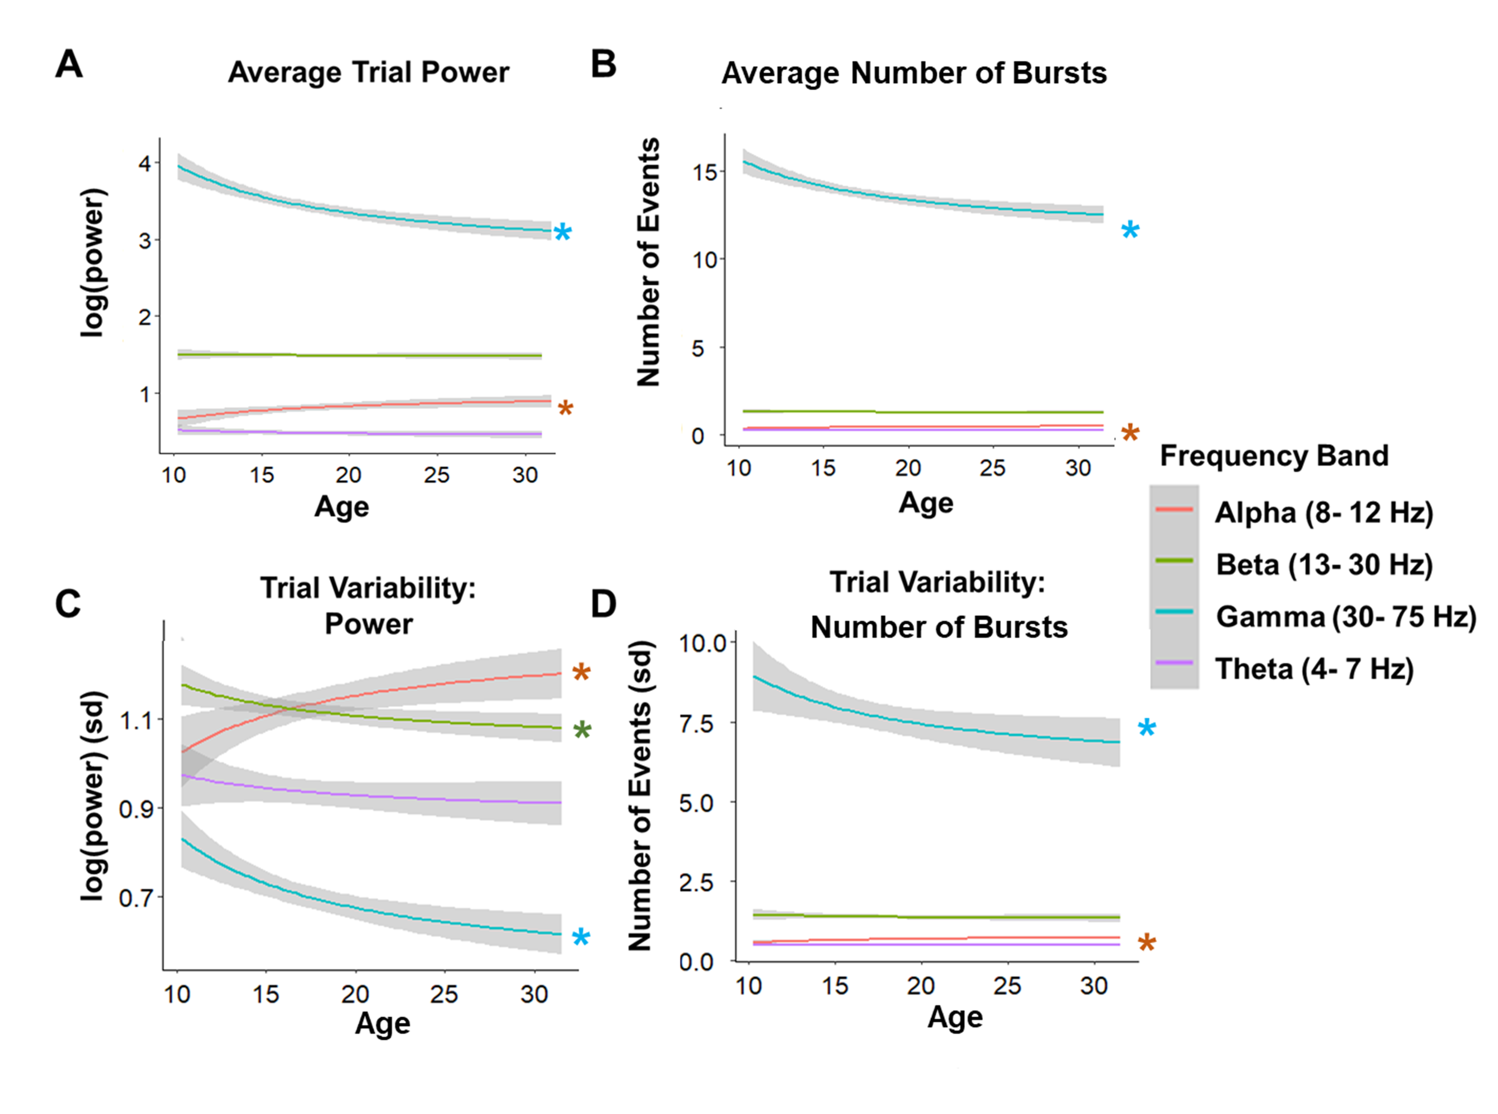
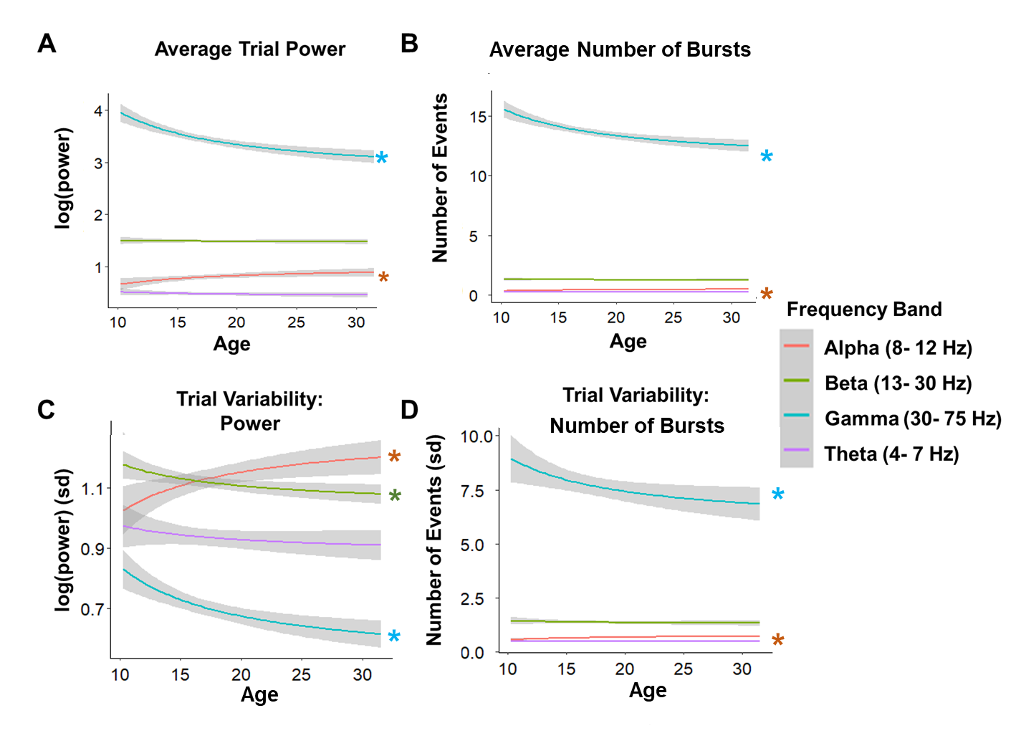
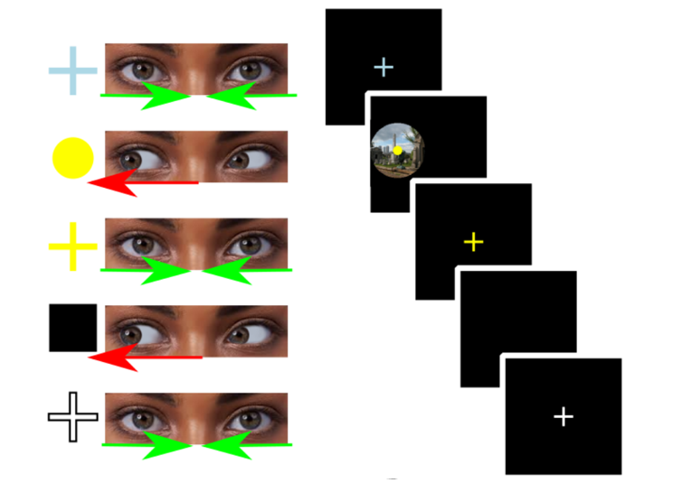
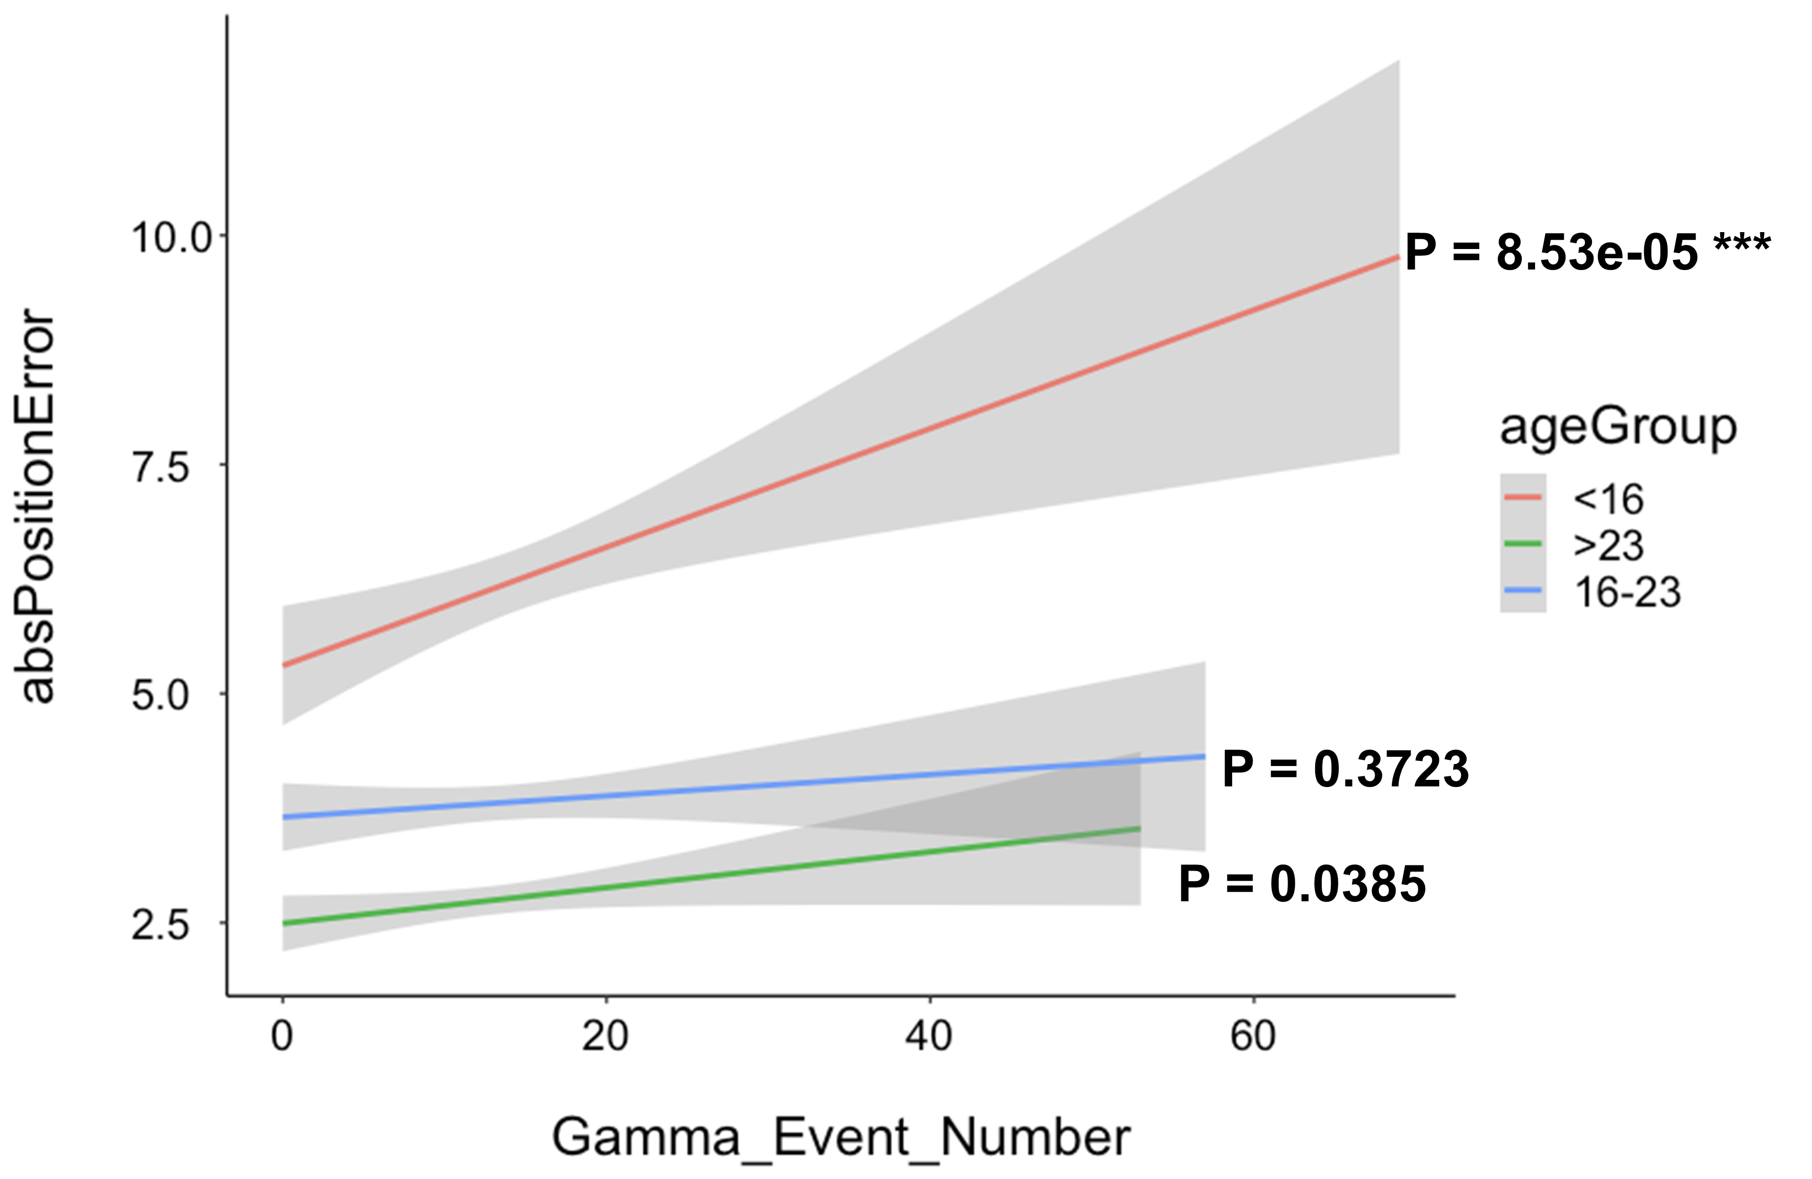
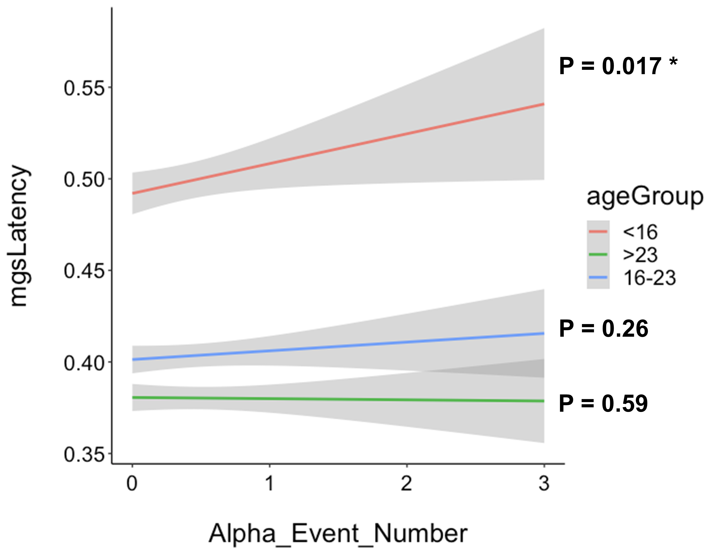
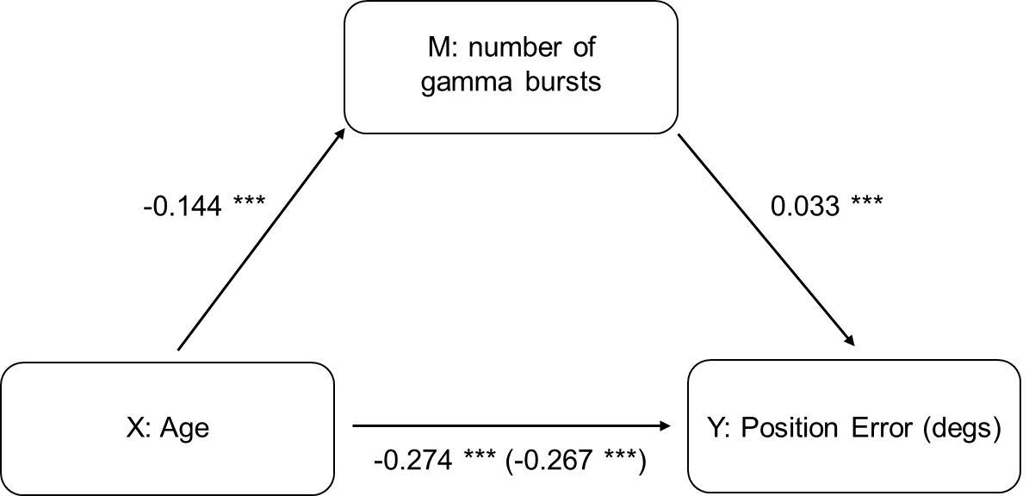
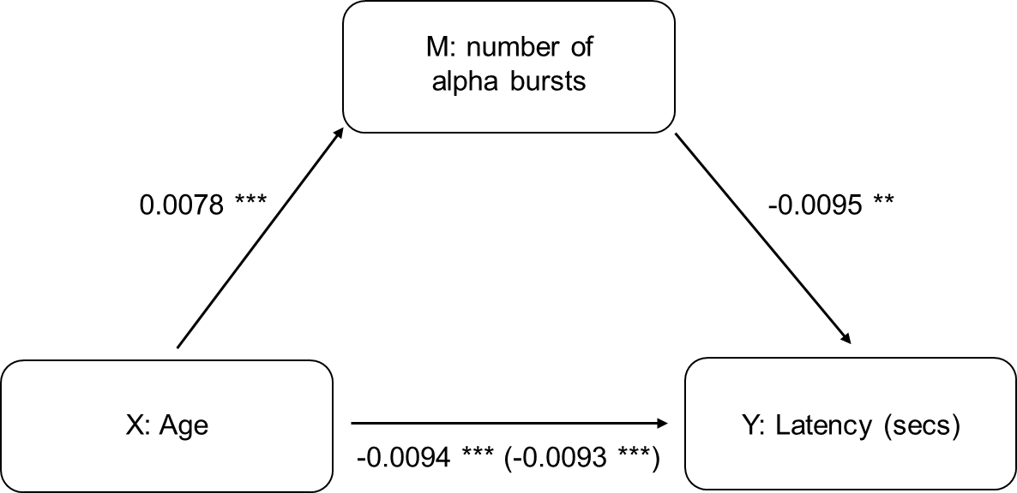
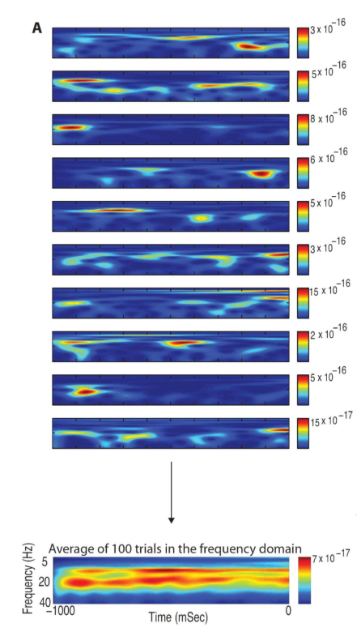
EEG- Derived Spectral Processing and the Development of Working Memory through Adolescence
Shane McKeon^{1,2}, Finnegan Calabro^{1,2,3}, Beatriz Luna^{2,3}
¹Department of Bioengineering, ²The Center for the Neural Basis of Cognition, ³Department of Psychiatry, University of Pittsburgh, Pittsburgh, Pennsylvania, USA.
introduction
wm mean accuracy and latency as well as variability improve into adulthood
From adolescence to adulthood there are significant improvements in executive function, notably in working memory, believed to be underlined by refinements in brain process that optimize whole brain function¹
Previous developmental EEG studies show age-related decreases in mean resting state transient brain rhythms across frequencies and band power^{5,6}
Single-cell studies, however, indicate that average brain rhythms cannot measure trial level transient activity, which is more directly associated with neural activation supporting higher-order cognitive tasks^{7,8}
Thus, we do not understand what aspects of age-related changes in neural function underlie improvements in executive function
study aims
trial level transient eeg activity during wm delay changed with age in gamma, beta, and alpha frequency bands
To delineate age-related changes in trial level transient EEG activity through adolescence into adulthood
To investigate the relationships between age-related changes in EEG activity and age-related improvements in working memory
methods
Participants:
140 healthy 10- 30 years olds (60 subjects evenly distributed between 10-17, and 80 participants distributed between 18-30) (73 = females)
Memory Guided Saccade (MGS) Task:
Visuospatial working memory task (Fig)
Participants look at a peripheral target and after a varied fixation delay period (6-10 sec), move their eyes to the remembered location
EEG Acquisition:
Biosemi ActiveTwo 64- channel EEG system
EEG Preprocessing:
Utilized a revised Makoto pipeline:
Removed flatline channels, low frequency drifts, noisy channels, short spontaneous bursts, and incomplete segments of data
Independent Component Analysis (ICA) was preformed to identify eye-blink and eye- movement artifacts
The number of gamma spectral events during delay mediates age- related improvements in accuracy
The number of alpha spectral events during fixation mediates age- related improvements in response latency
conclusions
Spectral Event Processing
Computed from 1s data windows
Delay and fixation epochs
Gamma (30- 75 Hz), theta (4- 7 Hz), beta (13- 30 Hz), and alpha (8- 12 Hz) frequency bands were analyzed using an established protocol in Shin et al⁸
A time-frequency responses (TFR)
Morlet wavelet equation
Normalized to the median power
The average value and trial-by-trial variability was calculated for event power, duration, and number of events per trial
Age-related trial level decreases in whole brain mean gamma and alpha power and variability in gamma, alpha, and beta bands suggest developmental improvements in the degree of neural activation supporting the ability to retain information on-line (gamma), controlling and integrating neural signals (alpha), and engaging top-down control (beta). Age related changes in gamma and beta bands may be underlined by developmental changes in GABA inhibitory and glutamate excitatory processing
Age-related decreases in the number of spectral bursts in gamma and alpha bands and its association with performance suggest that improvements in WM may be supported by the optimization of neural spiking. Decreases in power may support this process.
Results indicating that gamma mediates age-related improvements in WM accuracy suggest that critical to WM development is the ability to sustain WM information on-line.
Results indicating that alpha mediates age-related decreases in latency suggest maturational improvements in controlling and integrating neural signals
Together, results suggest that underlying developmental improvements in WM are optimization of neural processes that enhance sustaining information on-line (gamma), controlling and integrating neural signals (alpha), and implementing top-down control (beta)
EEG is averaged across trials. Creating what looks like a sustained rhythm
acknowledgements
references
This project was supported by Grant Number R01MH067924, the Staunton Farm Foundation, and the bioengineering department at the University of Pittsburgh
1. Luna, B., Marek, S., Larsen, B., Tervo-Clemmens, B. & Chahal, R. An Integrative Model of the Maturation of Cognitive Control. Annu. Rev. Neurosci. 38, 151–170 (2015).
2 Lebel, C., Walker, L., Leemans, A., Phillips, L. & Beaulieu, C. Microstructural maturation of the human brain from childhood to adulthood. NeuroImage 40, 1044–1055 (2008).
3. Simmonds, D. J., Hallquist, M. N., Asato, M. & Luna, B. Developmental stages and sex differences of white matter and behavioral development through adolescence: a longitudinal diffusion tensor imaging (DTI) study. NeuroImage 92, 356–368 (2014).
4. Silveri, M. M. et al. Frontal Lobe γ-Aminobutyric Acid Levels During Adolescence: Associations with Impulsivity and Response Inhibition. Biol. Psychiatry 74, 296–304 (2013).
5. Tierney, A., Strait, D. L., O’Connell, S. & Kraus, N. Developmental changes in resting gamma power from age three to adulthood. Clin. Neurophysiol. 124, 1040–1042 (2013).
6. Whitford, T. J. et al. Brain maturation in adolescence: concurrent changes in neuroanatomy and neurophysiology. HumBrain Mapp 28, 228–237 (2007).
7. Jones, S. R. When brain rhythms aren’t ‘rhythmic’: implication for their mechanisms and meaning. Curr. Opin. Neurobiol. 40, 72–80 (2016).
8. Shin, H., Law, R., Tsutsui, S., Moore, C. I. & Jones, S. R. The rate of transient beta frequency events predicts behavior across tasks and species. eLife 6, e29086 (2017).

Slide 2
EEG- Derived Spectral Processing and the Development of Working Memory through Adolescence
Shane McKeon^{1,2}, Finnegan Calabro^{1,2,3}, Beatriz Luna^{2,3}
¹Department of Bioengineering, ²The Center for the Neural Basis of Cognition, ³Department of Psychiatry, University of Pittsburgh, Pittsburgh, Pennsylvania, USA.

Slide 3
introduction
From adolescence to adulthood there are significant improvements in executive function, notably in working memory, believed to be underlied by refinements in brain process that optimize whole brain function¹
Previous developmental EEG studies show age-related decreases in mean resting state transient brain rhythms across frequencies and band power^{5,6}
Single-cell studies, however, indicate that average brain rhythms cannot measure trial level transient activity, which is more directly associated with neural activation supporting higher-order cognitive tasks^{7,8}
Thus, we do not understand what aspects of age-related changes in neural function underlie improvements in executive function
study aims
To delineate age-related changes in trial level transient whole brain EEG activity through adolescence into adulthood
To investigate the relationships between age-related changes in whole brain EEG activity and age-related improvements in working memory

Slide 4
methods
Participants:
140 healthy 10- 30 years olds (60 subjects evenly distributed between 10-17, and 80 participants distributed between 18-30) (73 = females)
Memory Guided Saccade (MGS) Task:
Visuospatial working memory task (Fig)
Participants look at a peripheral target and after a varied fixation delay period (6-10 sec), move their eyes to the remembered location
EEG Acquisition:
Biosemi ActiveTwo 64- channel EEG system
EEG Preprocessing:
Utilized a revised Makoto pipeline:
Removed flatline channels, low frequency drifts, noisy channels, short spontaneous bursts, and incomplete segments of data
Independent Component Analysis (ICA) was performed to identify and remove eye-blink and eye-movement artifacts
Spectral Event Processing
Computed from 1s data windows
Delay and fixation epochs
Gamma (30- 75 Hz), theta (4- 7 Hz), beta (13- 30 Hz), and alpha (8- 12 Hz) frequency bands were analyzed using an established protocol in Shin et al⁸
A time-frequency responses (TFR)
Morlet wavelet equation
Normalized to the median power
The average value and trial-by-trial variability was calculated for event power, duration, and number of events per trial
EEG is averaged across trials. Creating what looks like a sustained rhythm

Slide 5
wm mean accuracy and latency as well as variability improve into adulthood

Slide 6
trial level transient eeg activity during wm delay changed with age in gamma, beta, and alpha frequency bands

Slide 7
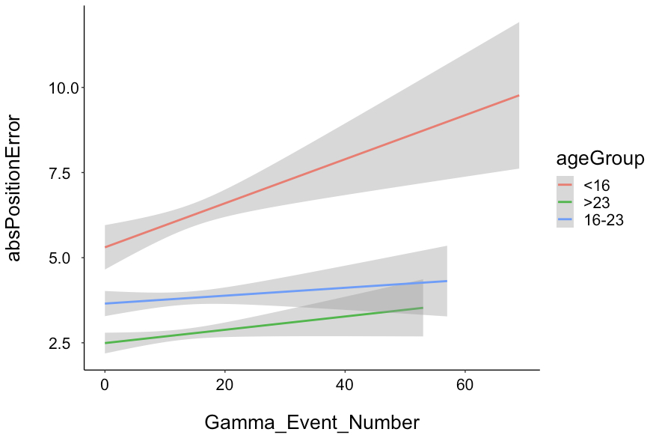
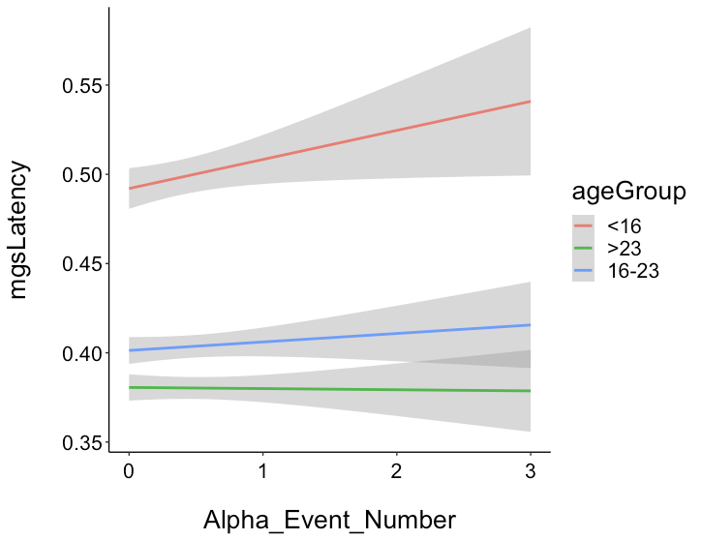
Increases in the number of gamma bursts are associated with increases in position error
Increases in the number of alpha bursts are associated with increases in latency
P = 0.017 *
P = 8.53e-05 ***
P = 0.26
P = 0.3723
P = 0.0385
P = 0.59
number of gamma band bursts mediate age-related improvements in accuracy
number of alpha band bursts mediate age-related improvements in response latency

Slide 8
conclusions
Age-related trial level decreases in whole brain mean gamma and alpha power and variability in gamma, alpha, and beta bands suggest developmental improvements in the degree of neural activation supporting the ability to retain information on-line (gamma), controlling and integrating neural signals (alpha), and engaging top-down control (beta). Age-related changes in gamma and beta bands may be underlied by developmental changes in GABA inhibitory and glutamate excitatory processing.
Age-related decreases in the number of spectral bursts in gamma and alpha bands and its association with performance suggest that improvements in WM may be supported by the optimization of neural spiking.
Results indicating that gamma mediates age-related improvements in WM accuracy suggest that critical to WM development is the ability for neural bursts to sustain WM information on-line.
Results indicating that alpha mediates age-related decreases in latency suggest maturational improvements in controlling and integrating neural signals
Together, results suggest that underlying developmental improvements in WM are optimization of neural processes that enhance sustaining information on-line (gamma), controlling and integrating neural signals (alpha), and implementing top-down control (beta)
Notes:
In conclusion our results are indicating

Slide 9
acknowledgements
This project was supported by NIH Grant Number R01MH067924, the Staunton Farm Foundation, and the bioengineering department at the University of Pittsburgh.
live zoom q&a
September 10, 2020
10:30am – 12pm EST
references
1. Luna, B., Marek, S., Larsen, B., Tervo-Clemmens, B. & Chahal, R. An Integrative Model of the Maturation of Cognitive Control. Annu. Rev. Neurosci. 38, 151–170 (2015).
2 Lebel, C., Walker, L., Leemans, A., Phillips, L. & Beaulieu, C. Microstructural maturation of the human brain from childhood to adulthood. NeuroImage 40, 1044–1055 (2008).
3. Simmonds, D. J., Hallquist, M. N., Asato, M. & Luna, B. Developmental stages and sex differences of white matter and behavioral development through adolescence: a longitudinal diffusion tensor imaging (DTI) study. NeuroImage 92, 356–368 (2014).
4. Silveri, M. M. et al. Frontal Lobe γ-Aminobutyric Acid Levels During Adolescence: Associations with Impulsivity and Response Inhibition. Biol. Psychiatry 74, 296–304 (2013).
5. Tierney, A., Strait, D. L., O’Connell, S. & Kraus, N. Developmental changes in resting gamma power from age three to adulthood. Clin. Neurophysiol. 124, 1040–1042 (2013).
6. Whitford, T. J. et al. Brain maturation in adolescence: concurrent changes in neuroanatomy and neurophysiology. HumBrain Mapp 28, 228–237 (2007).
7. Jones, S. R. When brain rhythms aren’t ‘rhythmic’: implication for their mechanisms and meaning. Curr. Opin. Neurobiol. 40, 72–80 (2016).
8. Shin, H., Law, R., Tsutsui, S., Moore, C. I. & Jones, S. R. The rate of transient beta frequency events predicts behavior across tasks and species. eLife 6, e29086 (2017).

